Slide 1
San Diego Miramar College
Calorie Application
Project Proposal
Andrew Wilson
Nguyen Nguyen
Sasanka Pallek
Wolfgang Schrott
Neema Adelinia
CISC 191
Professor Andrew Huang
March 28 2020

Slide 2
Team members and roles
Andrew Wilson: implementation of calorie database.
Nguyen Nguyen: Design and implementation of the User class and the App class.
Sasanka Pallek: Work on the App class. Help in the implementation of Food and Ingredient classes.
Wolfgang Schrott: Build the UI following the design.
Neema Adelinia: Design History class and DailyLog classes.

Slide 3
Purpose and justification
Our app gives users the ability to count their daily calories consumed. Calorie data will be imported from a database or via the user for convenience. Calorie counting is a popular method to achieve various fitness goals, but it can be challenging and time consuming, making commitment difficult. An app that makes calorie counting convenient and easy will help people stay committed and achieve their fitness goals.

Slide 4
Materials required
A database: FoodData Central
A workstation per team member
Github pro repository
Intellij
Git
Maven
Discord
Canvas
A tool to help visualize the app: FluidUI

Slide 5
Investigation/Development/Experimentation
The Calorie application’s UI will be created using JavaFX or Swing, discussed earlier in the course.
Furthermore, the classes will be inheriting properties from other classes. The database class will also be an abstract class with abstract and non abstract methods. Covering the class topic on inheritance, abstract classes, and interfaces.
The calorie application will allow user to create an account. The login credentials as well as other user information will be read and stored. This covers I/O streams discussed in the class.
Also, many classes will be using ArrayLists to store objects and then iterate through the items and calculate sums , or find items. One class would History class that will use an ArrayList of object DailyLog to store user’s daily logs.
Lastly, the app will use an online database and also store/call serializable objects. This will cover the Networking that was discussed in the course.

Slide 6
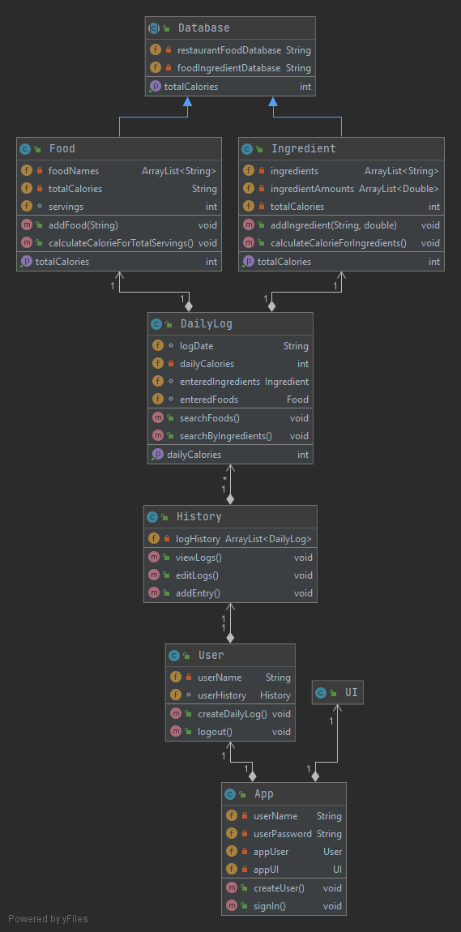
UML Diagram

Slide 7
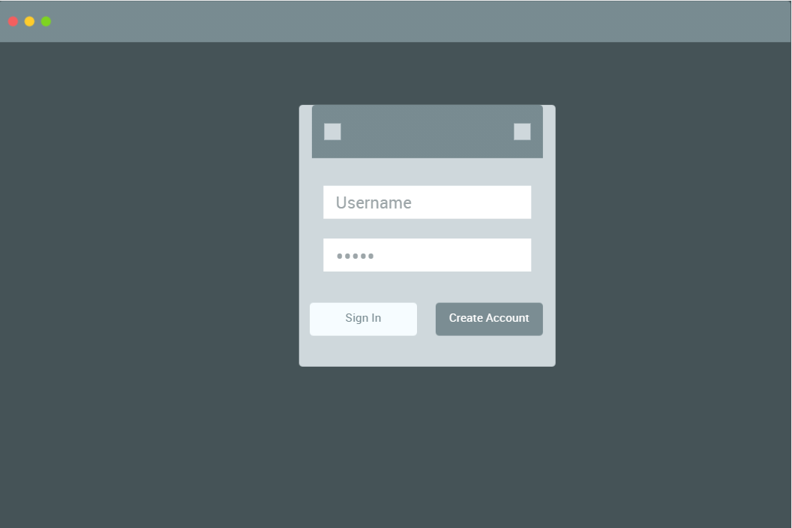
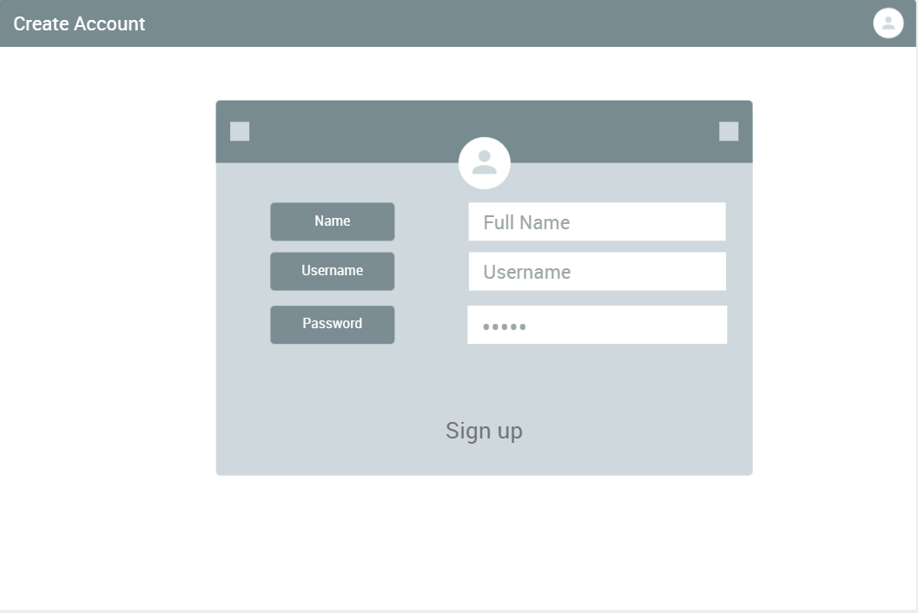
UI prototype

Slide 8
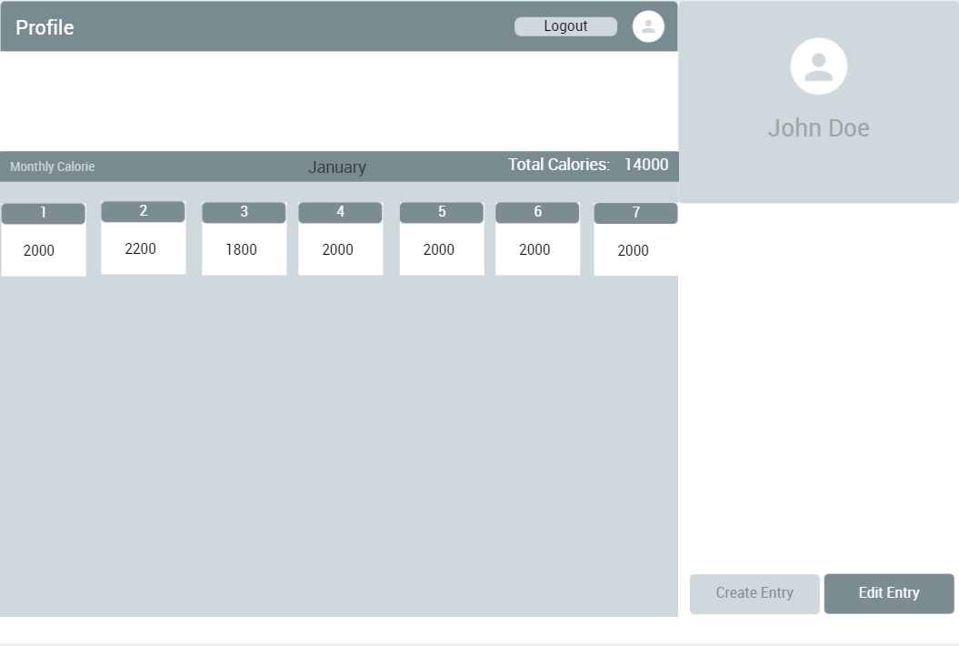

Slide 9
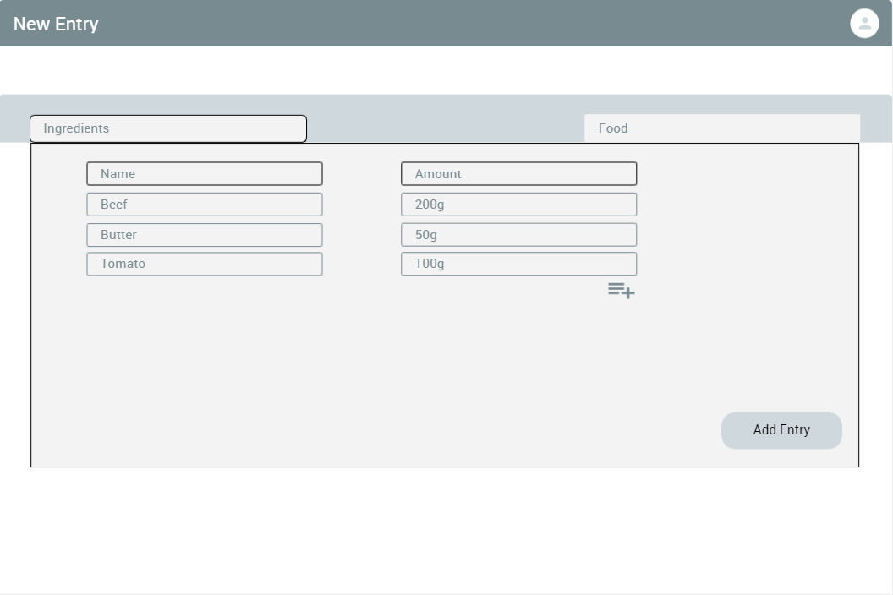
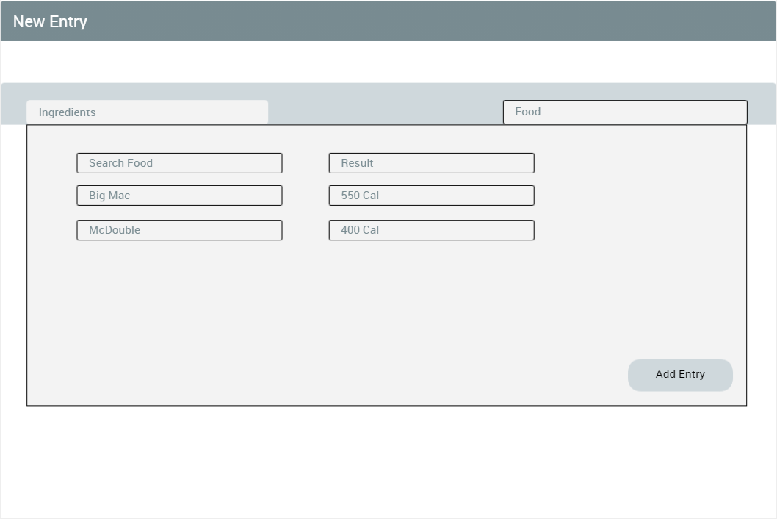
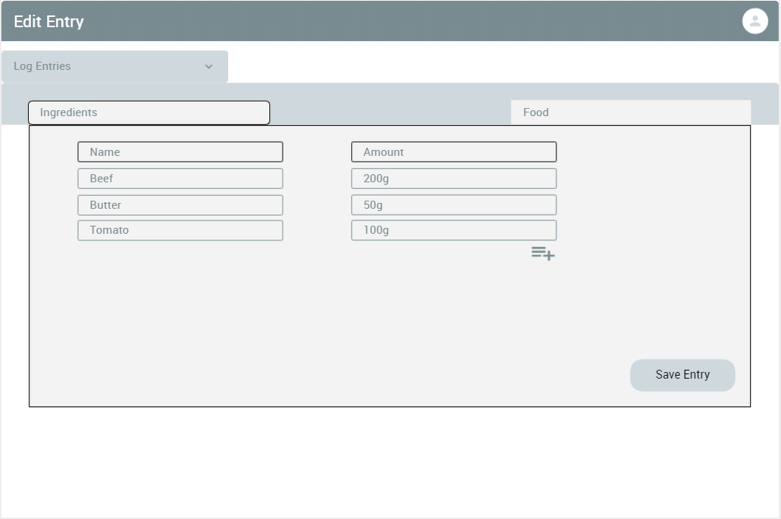

Slide 10
Tasks, time estimates, owners, and dependencies
Task | Estimate Time | Owner | DependsOn | Status
UML diagram | 1 Week | Team | Team Discussion | Completed
App UI prototype | 1 Day | Sasanka | UML diagram | Completed
Class UI | 1 Week | Wolfgang | App UI prototype | Incomplete
Classes History and DailyLog | 1 Week | Neema | Indirect - Food and Ingredient classes | Close to Completion
Class User | 1 Week | Nguyen | Indirect - History and DailyLog classes | Close to Completion
Class App | 1 Week | Sasanka | Indirect - UI and User classes | Needs UI to complete
Abstract Class Database | 1-2 Week | Andrew | Database Found | Close to Completion
Classes Food and Ingredient | 1-2 Week | Andrew, Sasanka | Direct - Database | Close to Completion
Indirect - Contains object of type
Direct - extends/implements
Note: Couple classes need networking done.
UI is not ready.

Slide 11
Problems and Solutions:
The previous arrangement of classes into client/common/server did not work with few classes as dependencies increased, circular dependency occurred.
We did not have a way to store user accounts.
Finding a Database good for our apps needs
We moved the abstract database class and Food and Ingredient classe from server to common. Methods within the two classes were changed to static for easier access.
A new server class storing user accounts. Signing to an existing account will also utilize this in verification.
Able to find a csv file containing more than 8000 foods/ingredients and their calories amount for 100g.

Slide 12
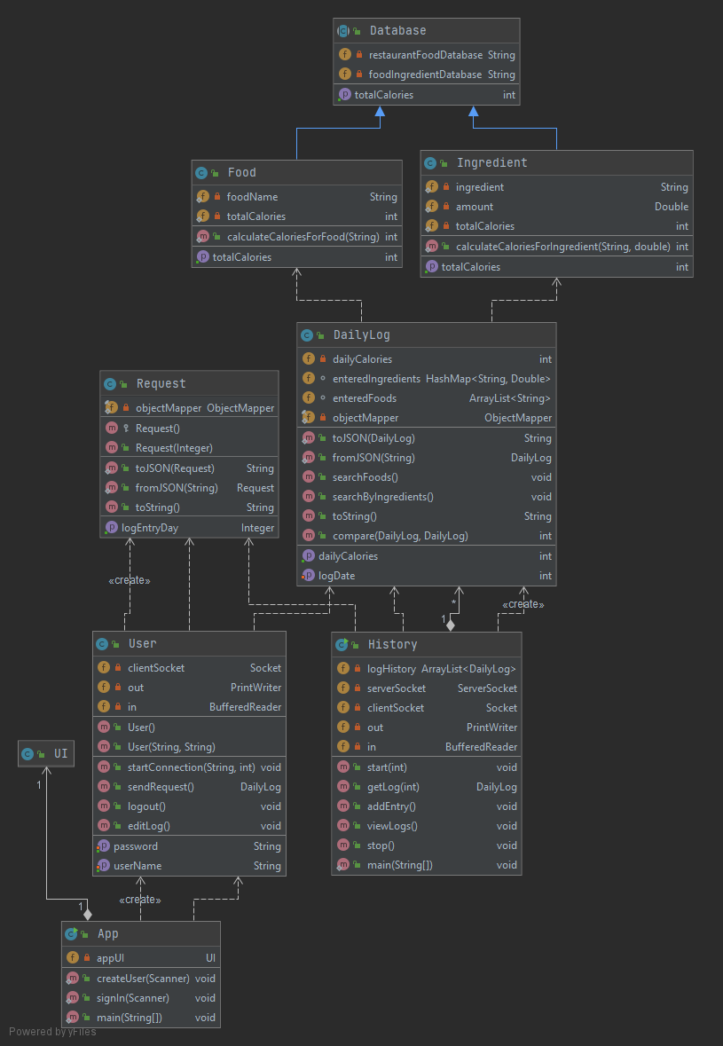
Updated UML

Slide 13
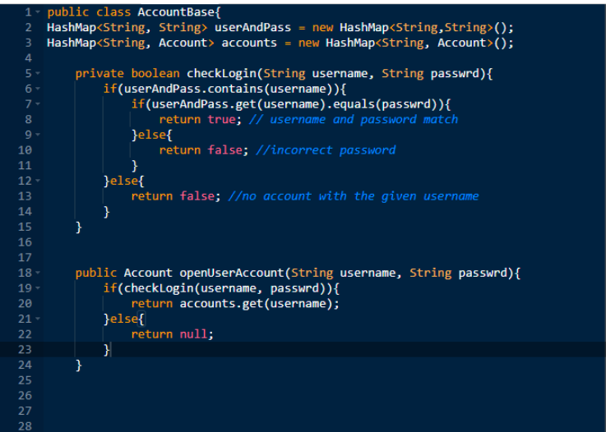
Modifications:
Possibly merging both Food and Ingredient classes into one as they are both using the same database. Only difference the amounts of ingredients.
A new server class to hold user accounts and it will likely use HashMaps in a similar way to the following:

Slide 14
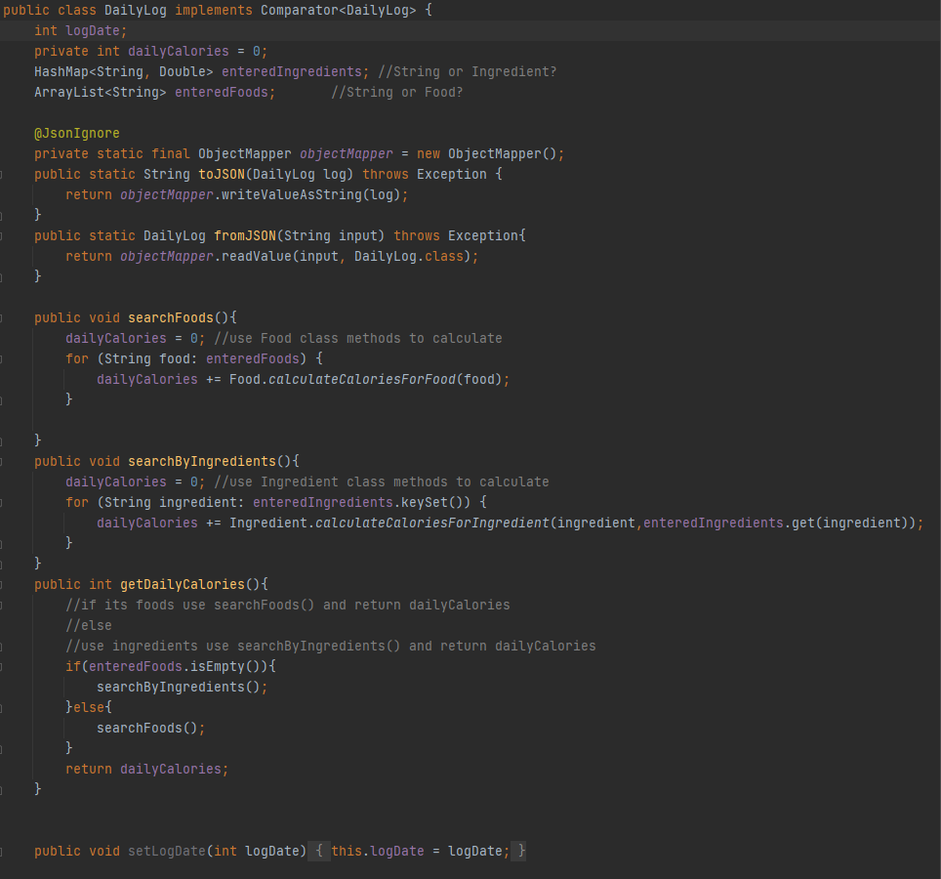
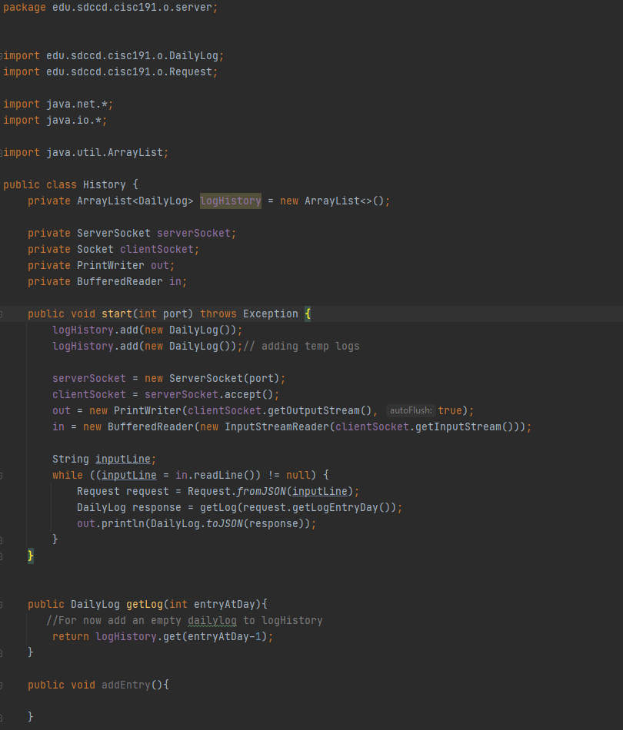
History & DailyLog classes

Slide 15
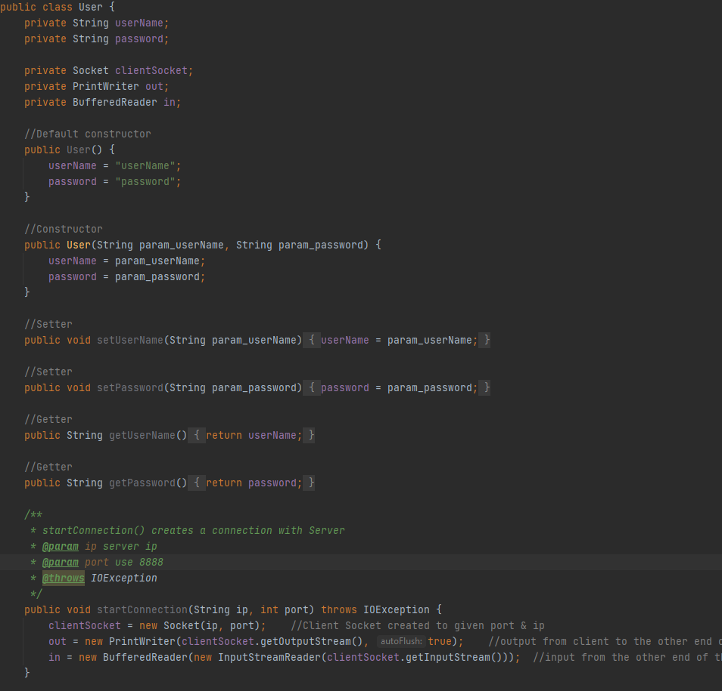
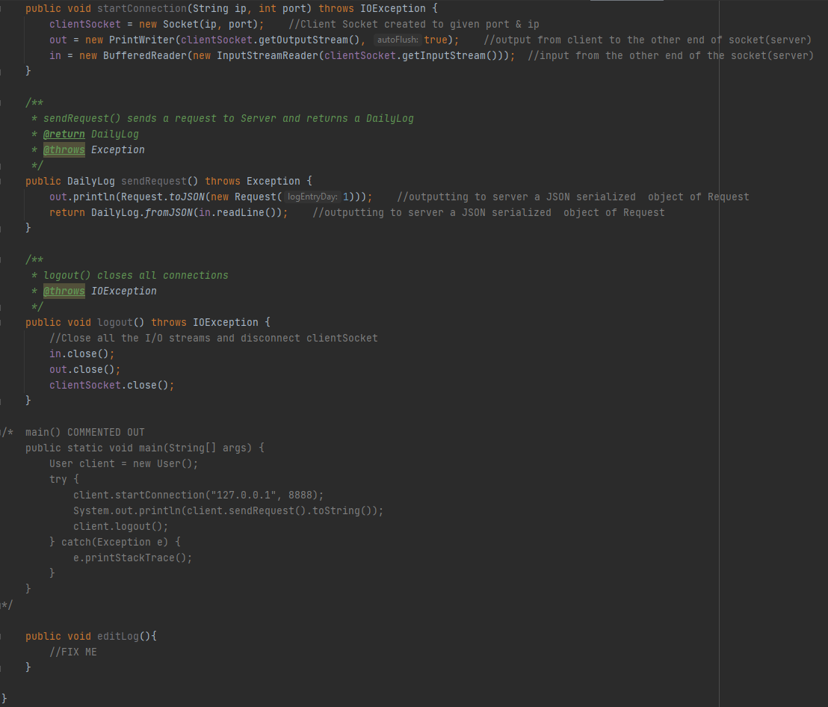
User Class

Slide 16
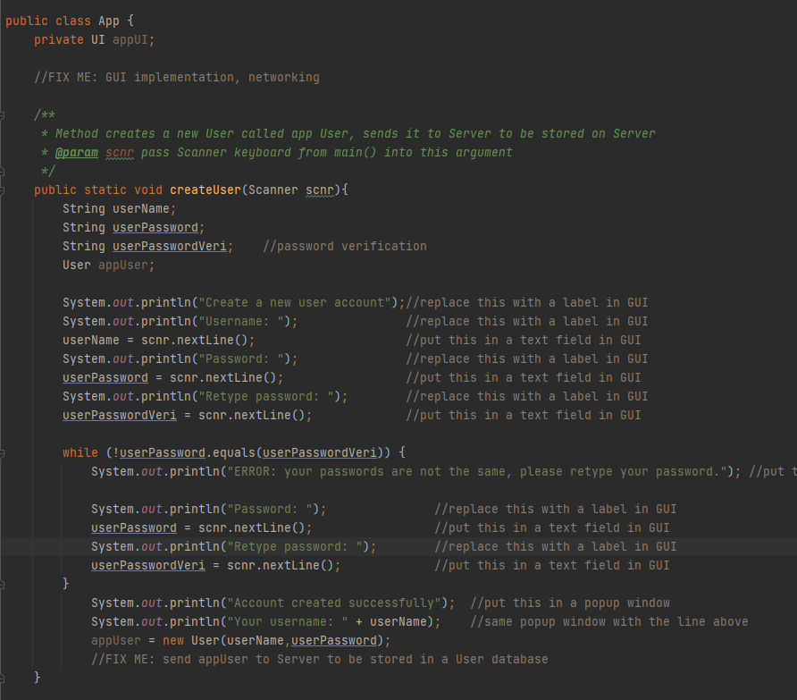
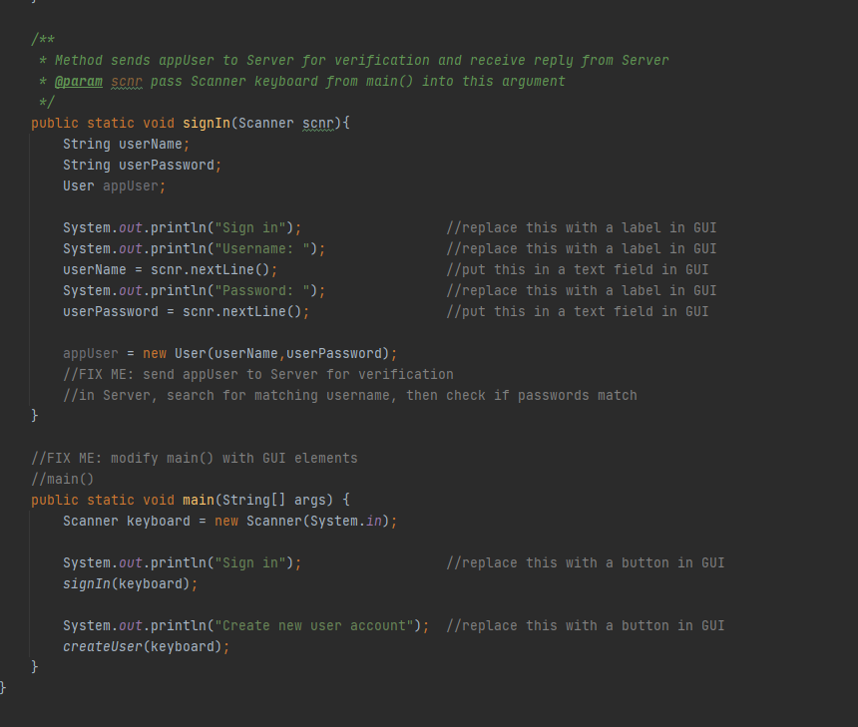
App Class

Slide 17
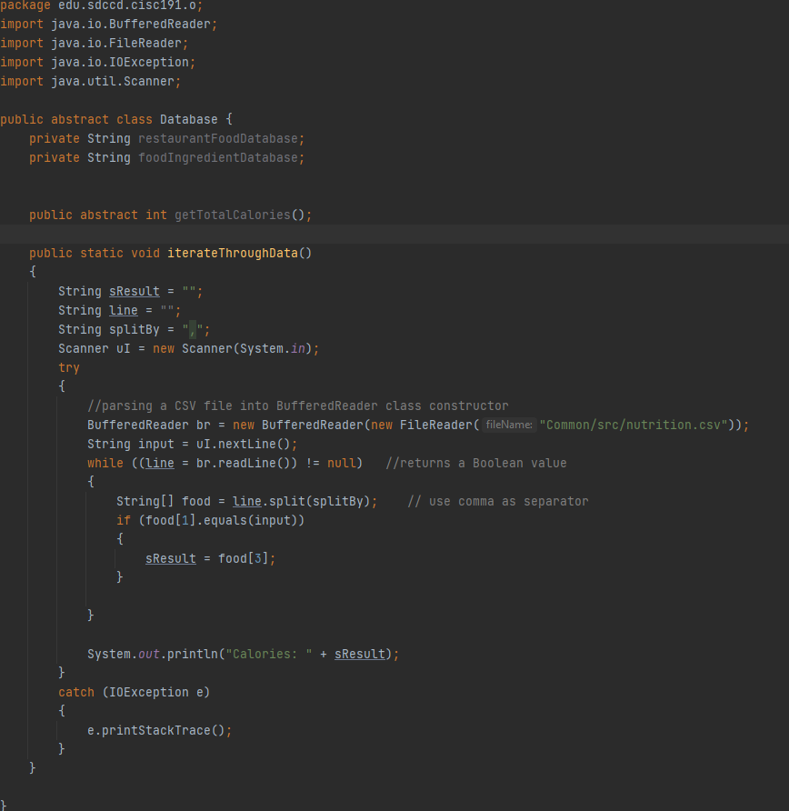
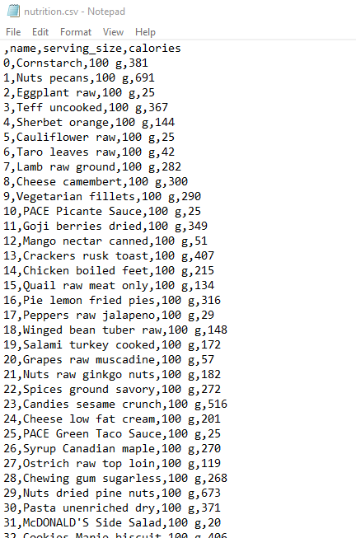
Database

Slide 18
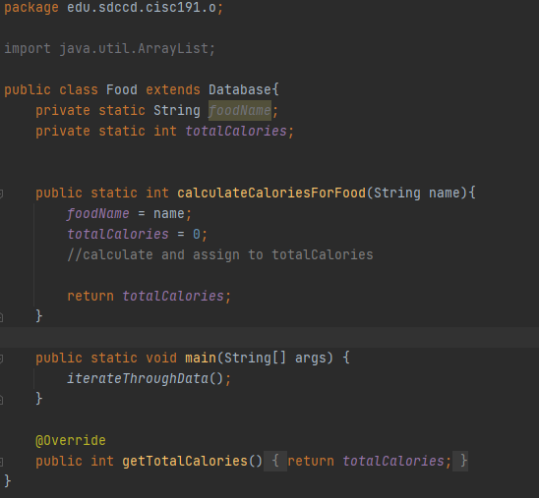
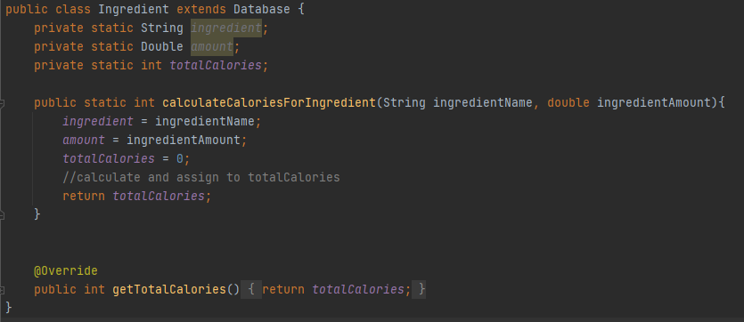
Food & Ingredient Classes

Slide 19
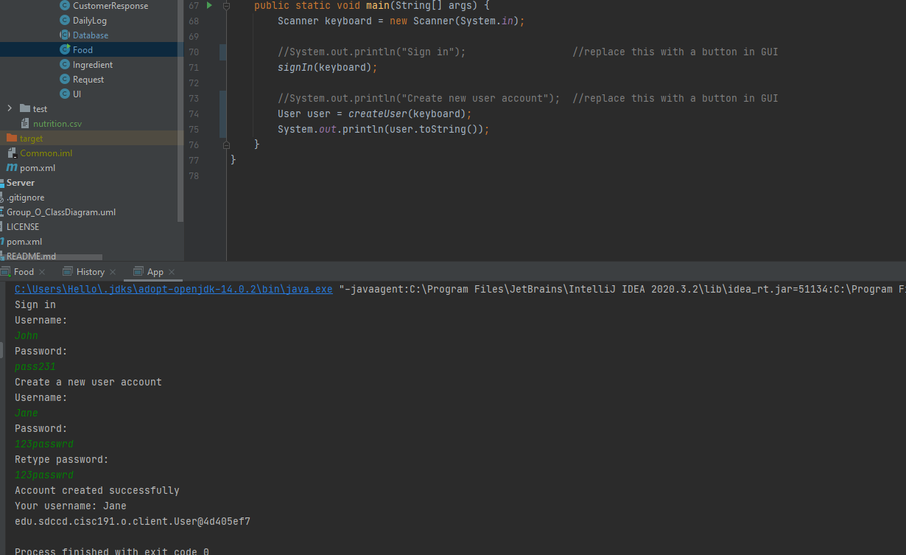
Running Code (without UI implemented)

